Slide 1
COMMUNITY MIDWIFERY

Slide 2
Background information
Evidence from a number of studies globally has shown a reduction in maternal and perinatal mortality when women have access to a skilled attendant providing a continuum of care from pregnancy, at birth and during the postnatal period.
In Kenya, as in most of sub‐Saharan Africa, although the majority (88%) of women attend antenatal clinic at least once during pregnancy, more than half (58%) give birth at home without any skilled assistance, and only 10% of those delivering at home receive any type of postpartum care.

Slide 3
The maternal mortality ratio in Kenya of 360 per 100,000 live births by DHS in 2014 is unacceptably high. The neonatal mortality rate for the five years preceding the survey is 22/1000 live births, with majority of the deaths occurring within the first week of life.
The infant mortality rate is 39 per 1000 live births. The use of modern methods of Fp increased from 32%-53% between 2003-2014. unmet need for Fp 18% of married women age 15-49 years
3:5 (61%) children are exclusively breastfeeding at six months, from 32% in 2008-2009, vaccination coverage almost 8 in 10 children (79%) age 12-23 months have received all basic vaccinations. 2% have received no vaccines

Slide 4
Midwifery is a healthcare profession in which providers offer care to childbearing women, labour, childbirth and during the postpartum period. They also care for newborn and assist mothers to breast feed (WHO, 2012).
The utilization of skilled midwives visiting the homes during the first week after birth is therefore recommended as an opportunity to identify complications in the mother and baby during a period which culturally prevents women from leaving their homes during the first month after birth.

Slide 5
The Community midwife is an integral part of the community level which encompasses the provision of skilled care within the homes and provides a link to the formal health sector.
A healthy community for pregnant women, mothers and newborns is an informed, participatory and supportive community, playing an active role for supporting access to skilled care, such as developing financing and transport schemes… The role of men and other influentials or decision makers is to be considered when designing health community programmes for maternal and newborn health. (WHO 2003)

Slide 6
Community midwifery(domiciliary)
Care given at home set-up to antenatal mothers from pregnancy, labour, and delivery to postpartum period by use of skilled birth attendants.
The midwives are attached to general practice and works in the community as part of PHC team(Medical Glossary, 2010).

Slide 7
Community Midwife
A skilled attendant is a midwife, nurse, clinical officer or Doctor with midwifery skills. He or she resides in the community and have been educated and trained to proficiency in the specific skills required to manage normal pregnancies, childbirth, and immediate postnatal and in identification, management and referral of complications in pregnant or recently delivered woman and newborns.
(WHO 2005)

Slide 8
Traditional birth attendants (TBAs) whether trained or not, are not considered skilled attendants at birth
Traditional birth attendants, trained or untrained, are excluded from the definition of skilled attendants
– lack of clinical skills, drugs and equipment, or
infrastructure to manage complications such as
haemorrhage, eclampsia, or severe infection

Slide 9
Kenya Community midwifery model and Health Policy context in Kenya
CMM Was commissioned by the minister of health in 2006 as an attempt to increase access to skilled assistance at birth.
First edition CM guidelines dev in 2007.
Revised guidelines address key policies outlined in the Kenya Health Policy(2012-2030) regarding provision of essential packages for health in line with the new const., vision 2030 and the Community Health Strategy.

Slide 10
The health policy objectives are to:
Eliminate communicable conditions;
halt, and reverse the rising burden of non-communicable conditions;
reduce the burden of violence and injuries;
provide essential health care;
minimize exposure to health risk factors
strengthen collaboration with health related sectors.

Slide 11
Kenya Health Sector Strategic and Investment Plan
The Kenya Health Sector Strategic and investment plan (KHSSP) for the period 2012- 2018 emphasizes the implementation of interventions and prioritization of investments that relate to maternal and newborn health

Slide 12
Kenya’s constitution (2010), Service Delivery levels and Essential Package for Health
The constitution recognizes equal access to health care systems
Due to devolution, the service delivery levels are organized in four tiers:
Community level: The foundation of the service delivery system
Primary care level: dispensaries, health centres & maternity /nursing homes. Most clients needs are addressed
County level:The first level hospitals, whose services complement the primarycare level to allow for a more comprehensive package of services.
National level: The tertiary level hospitals, services are highly specialized

Slide 13
KEPH services offered at community level
These include: immunizations, child health, maternal and newborn health, family planning among others.
These services are offered by; Community Health Workers (CHWs), Community Health Extension Workers (CHEWs) and Community Midwives.

Slide 14
Implementation experience with CM model
In original CM model, was CM expected to conduct delivery in a woman's home. However some common reasons were cited by women to include, lack of privacy in their own homes and inadequate space especially where the family stays in one room. On the other hand CM cited insecurity (especially at night), long distances that let to delay in receiving health care.

Slide 15
THE PHASES OF DELAY
Delay in receiving care has been described in three phases (sometimes called the three delays):
Phase 1. Decision to seek care
Phase 2. Reaching the medical facility
Phase 3. Receiving adequate treatment.

Slide 16
Phase 1. Delay in decision to seek care This is affected by:
Economic status
Educational status
Women’s status
Illness characteristics

Slide 17
Phase 2. Delay in reaching the medical facility This is affected by:
Distance
Transport
Roads
Cost.

Slide 18
Phase 3. Delay in receiving adequate treatment
What quality of care can women expect at health facilities?
Is there always the right kind of help available?
The right kind of help means:
Skilled staff
Drugs
Sterile equipment, and
Blood for transfusion.

Slide 19
Factors that influence motivation and work behaviour of community based workers:
• Hopes for better life through continuous development of life skills and opportunities
• Personal interest
• Administrative environment (government regulations, laws, procedures, support)
• Community factors
• Political and policy environment
• The strength of the governing structures linking the community and health system
• Training of health workers, supervisors and managers in participatory skills
• Supportive supervision by a multidisciplinary team of professionals

Slide 20
Roles and responsibilities of a CM
✓ Providing care to women and their family members (Health promotion activities and service provision)
✓ Serving as a link between level I and the formal health system
✓ Data collection and reporting

Slide 21
Care provided to women and their families
Divided into two broad areas: Health promotion activities and service provision in maternal and newborn as well as reproductive health service areas.

Slide 22
Roles and responsibilities of a CM
Reducing the three delays
The CM provides health promotion and educates women, men and particularly grandmothers and families on:
• Importance of when and where to seek health care services during pregnancy, labour childbirth and the postnatal period (for mother and baby)
• Information on importance of testing for HIV and referral for VCT and PMTCT
• The importance of an individualized birth preparedness and postnatal plan
• Assists the woman and her family to prepare a birth, postnatal care plan including postpartum family planning

Slide 23
• Identification of danger signs in pregnancy labour, childbirth and postnatal period
• Recognition of danger signs in the newborn including sepsis to ensure family seek early treatment
• How to prepare or plan for emergencies (funds ,support, permission etc)
• Reproductive health knowledge among women and their male partners
• The importance of health timing and spacing of pregnancies
• The availability of family planning commodities
• Importance of completing all immunizations in infants/children

Slide 24
Selection criteria
The following prerequisites are essential and should be verified with the relevant professional body;
Registered Nurse/ Midwife; enrolled Nurse/ Midwife Registered.
Clinical officer
Medical office

Slide 25
A retired or out of employment health professional with obstetric/midwifery skills
Has residency within the community to be served
Evidenced of retention on a professional register
Get involved in the running of health related or welfare activities within the community as a sign of communities trust in them.
Be ready to be supervised and monitored by the DHMT$ Supervisory Team(Rural Health Coordinators)

Slide 26
Link with the health care system through the nearest health facility for support e.g. updates, transport, supplies, equipment and their sterilization.
To work closely with the community leaders and community groups to identify the most common health problems and work together for solution.

Slide 27
Criteria for Licensing Community Midwives
1. Must be a Kenyan citizen.
2. The applicant must be a registered or enrolled community health nurse or midwife by the Nursing Council of Kenya.
3. Must be holding a current practice licence.
4. Must be either, retired, resigned, unemployed or a licensed nurse private practitioner.
5. Must be trained on essential obstetric care and certified by the DHMT.
6. Must present a letter of introduction from the DHMT.
7. Private practitioners may be licensed as community midwives on condition that they deliver the mothers in their homes.
8. Must have had a 6 months experience in a maternity set up post registration/ enrolment.
9. Must have worked for at least 10 years post registration/enrolment.

Slide 28
Criteria for Licensing Community Midwives
10. Must submit, together with application and recommendation letter latest curriculum vitae detailing:
i. Date of registration/enrolment,
ii. Registration/enrolment number,
iii. Continuing education in the last one year,
iv. Name and address of last employer (if any),
v. Last date of employment,
vi. Areas of practice (deployment) since qualification,
vii. The applicant should also present:
a. Certified copies of registration/license and enrolment certificates
b. Copy of ID card

Slide 29
Criteria for Licensing Community Midwives
11. Indicate the nearest health facility where he/she can refer his clients to.
12. Appear in person for initial application and renewal of the license at the Council offices.
13. Will pay the prescribed fee for licensure and license will be renewable every
three years.
14. Always carry on them the license when performing the community midwifery services.
15. A midwife undertaking community midwifery must not, except in grave emergency, undertake any treatment which is outside his/her normal professional practice.

Slide 30
Criteria for Licensing Community Midwives
. A nurse midwife undertaking community midwifery must refer to the nearest health facility all cases he or she is unable to manage.
17. The midwife must keep custody of all clients' records and submit a copy to the DHMT at the end of every month.
18. If the client dies, the midwife in attendance at the time of death or who was called immediately shall notify the DHMT and police within 48 hours.
19. A midwife undertaking private practice must bear any legal liability relating to his/her practice.
20. A nurse/midwife undertaking community midwifery must observe rules and regulations set from time to time by the Nursing Council of Kenya and the DHMT.

Slide 31
Referral system
It is an interlinked network of service providers and facilities that provide a continuum of care for acute and chronic illnesses.
A CM should be conversant with the referral protocols i.e. fill the appropriate referral form, refer to the most appropriate health facility, initiate management in case of emergency, secure transport, and alert the receiving facility.

Slide 32
Data collection
Compile data, write and submit reports to the local health management teams and committees promptly.
Register or advice the woman on where to register the birth.
Notify the civil registration office/ health facility of any death in the community
Share monthly reports with the link health facility using the appropriate register(s)
Document the number of referrals; reasons, means of transport used, source of funds, person accompanying the patient and the outcome of referral process (if known)

Slide 33
Drugs, equipment and supplies
CM will stock and administer the following drugs:
Oxytocin,antibiotics, anticonvulsants, analgesics, local anesthesia, routine haematinics, IPTp in malaria, antihelminthics, PMTCT ARV prophylaxis during labour, intravenous fluids as per guidelines, TEO, vitamin K.
They should have sufficient equipment and supplies to able to perform procedures well.

Slide 34
Scope of practice
The Community midwives scope of practice is preconception care, counselling, normal pregnancy, childbirth, postpartum, newborn care and family planning.

Slide 35
Training
All CM will undergo orientation training before they are accredited/allowed to practice in this capacity
Must complete the following steps:
Orientation
Clinical attachment in a busy health facility for skills updates.
Certification ,and
Licensing

Slide 36
Orientation focus on
Maternal and newborn
Maternal and perinatal death surveillance and response
Recording and reporting data
Infection prevention and control
Family planning
Communication and referral
Interpersonal and communication skills
Enterpreneurship and marketing skills

Slide 37
Clinical attachment
Should be at a busy health facility where there is a high client load and range of maternal and newborn health care services provided.
CM uses a log book to record required procedures which should be carried out under supervision.

Slide 38
Certification
Done by the ministry of health after completion of all the procedures outlined In the log book.
A regulatory board will the issue a license to the health provider to practice in the community.
Then, the CM will be required to have relevant regular updates and refresher courses in order to meet requirements for retention.

Slide 39
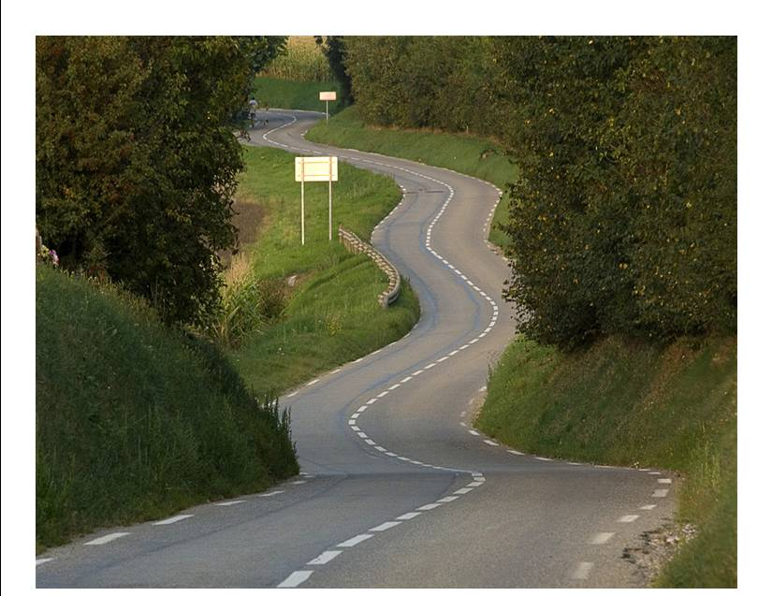
Finally
To get to improvement and outcomes is not a fast process; a long road to travel

